Slide 1
Deployment, Hosting and Monitoring
SoftUni Team
Technical Trainers
Software University
https://softuni.bg

Slide 2
Table of Contents
Deployment
Actuator
Micrometer
Prometheus

Slide 3
Have a Question?
sli.do #java-web

Slide 4

Deployment

Slide 5

What is Deployment?
Deployment means to push changes or updates from one environment to another

Slide 6
Where to Deploy?
We can deploy one project onto multiple websites
Some of the deployment websites
Heroku
Amazon Web Services (AWS)
Google Cloud Platform

Slide 7
Deploying On Heroku
There are 3 ways to deploy a project on Heroku
Using Git (Heroku Git, Heroku CLI)
Using Github
Using the Container Registry (Heroku CLI)

Slide 8

Procfile and System.properties
Before running our project, we should add 3 important keys to deploy the project
Create 2 new files in our project folder
Procfile
system.properties

Slide 9
System.properties
system.properties
Holds all of the system configuration properties needed to run the project
By default, Heroku uses JDK Version 1.8
To specify specific version:
java.runtime.version={version}

Slide 10
Procfile
Procfile
Holds the executed commands by the application on startup
Should include:
web: java -jar target/{name}-{version}.jar
pom.xml
<version>1.0.0-SNAPSHOT</version>
<name>project_name</name>

Slide 11
Application.properties
application.properties
spring.datasource.url=${JDBC_DATABASE_URL:}
spring.datasource.username=${JDBC_DATABASE_USERNAME:}
spring.datasource.password=${JDBC_DATABASE_PASSWORD:}
server.port=${PORT:8080}
spring.datasource.hikari.connection-timeout=30000
spring.datasource.hikari.maximum-pool-size=10
spring.jpa.properties.hibernate.dialect = org.hibernate.dialect.PostgreSQLDialect

Slide 12
Managing config vars (1)
Using the Heroku CLI
View current config var values
Set a config var
$ heroku config
GITHUB_USERNAME: ivan
OTHER_VAR: student
$ heroku config:get GITHUB_USERNAME
ivan
$ heroku config:set SOME_SECRET = mySecret
Adding config vars and restarting myapp... done, v12
SOME_SECRET: mySecret

Slide 13
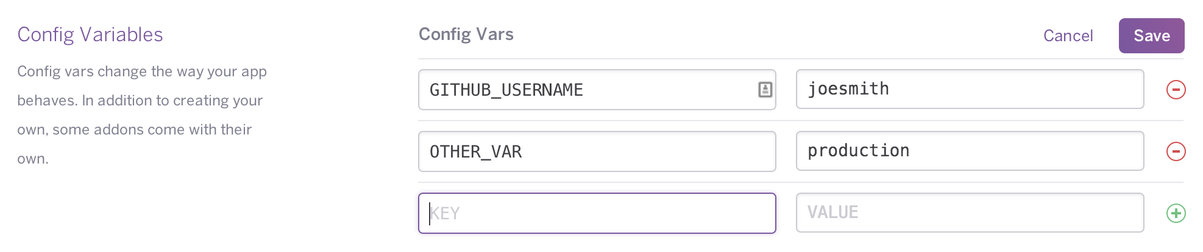
Managing config vars (2)
Using the Heroku Dashboard
Using the Heroku Dashboard
You can manage your app’s config vars programmatically with the Heroku Platform API using a simple HTTPS REST client and JSON data structures

Slide 14

Deploy with Git

Slide 15
Deploying On Heroku with Git (1)
Download Heroku CLI
In the bash terminal, write the command
For creating a new Git repository
Go to the directory of the project
In the bash terminal, write
heroku login
git init

Slide 16
Deploying On Heroku with Git (2)
Create a new Git repository
Create a new Heroku project and bind it with the git repository
git add .
git commit
heroku create
git remote -v
heroku git: remote -a <project-name>

Slide 17
Deploying On Heroku with Git (3)
Add the PostgreSQL addon
Push the project to Heroku
Change the ps:scale
Check logs
heroku addons:create heroku-postgresql
git push heroku master
heroku ps:scale web=1
heroku logs --tail

Slide 18

Deploy with Github

Slide 19
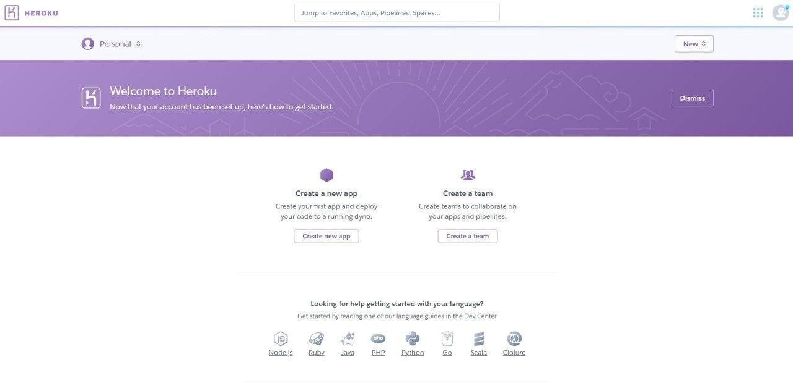
Deploying On Heroku with Github (1)
Create a registration in the Heroku website

Slide 20
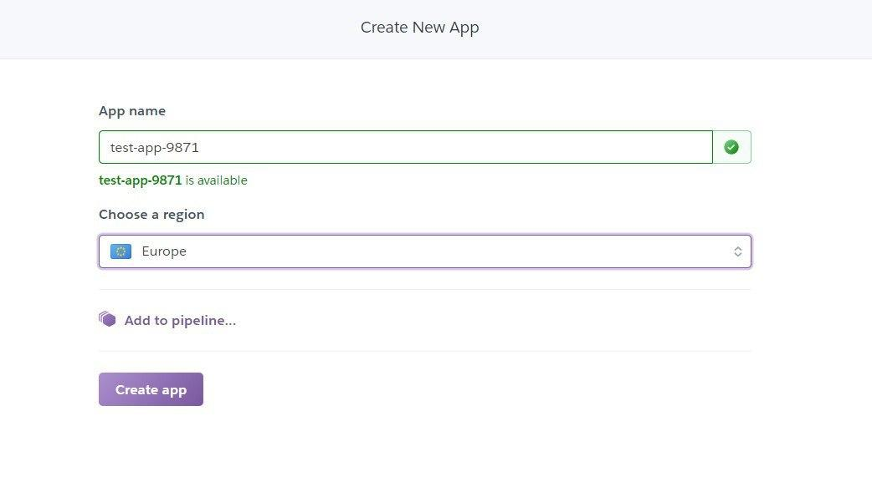
Deploying On Heroku with Github (2)
Create a new App

Slide 21
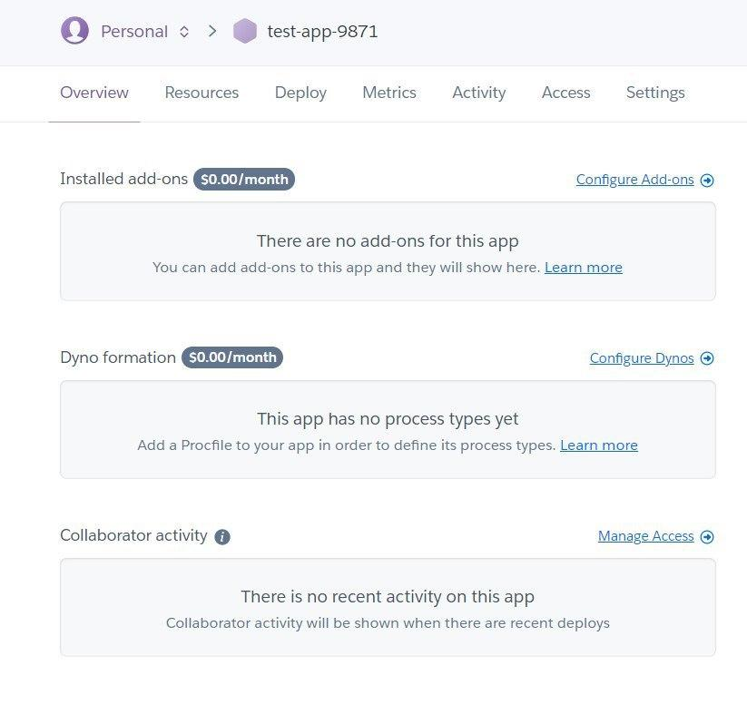
Deploying On Heroku with Github (3)
Add to the installed add-ons:
heroku-postgres

Slide 22

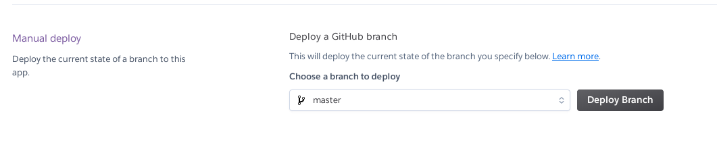
Deploying On Heroku with Github (4)
Go to deploy tab, check "Github" and add your repository

Slide 23

Actuator
Monitor and manage your application

Slide 24
Actuator
Spring Boot includes a number of additional features to help you monitor and manage your application when you push it to production
You can choose to manage and monitor your application by using HTTP endpoints or with JMX
Auditing, health, and metrics gathering can also be automatically applied to your application

Slide 25
Actuator dependency
The recommended way to enable the features is to add a dependency on the spring-boot-starter-actuator 'Starter'.
<dependencies>
<dependency>
<groupId>org.springframework.boot</groupId> <artifactId>spring-boot-starter-actuator</artifactId>
</dependency>
</dependencies>

Slide 26
Actuator Endpoints
Endpoints let you monitor and interact with your application
Spring Boot includes a number of built-in endpoints and lets you add your own
Each individual endpoint can be enabled or disabled and exposed

Slide 27
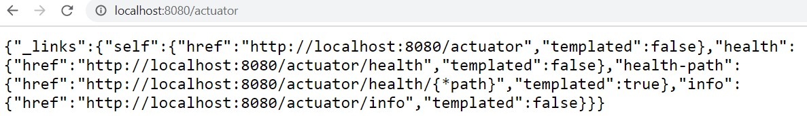
Actuator example
For example, by default, the health endpoint is mapped to /actuator

Slide 28
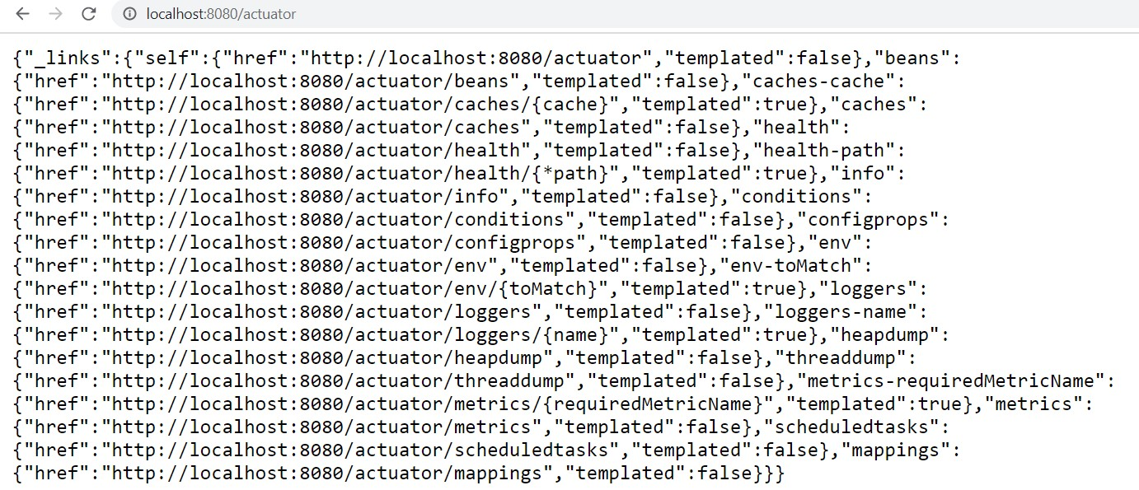
Expose all actuator endpoints
To expose all actuator endpoints you need to add in application.properties file:
management.endpoints.web.exposure.include=*

Slide 29
Enabling Endpoints
If you prefer all endpoints to be disabled
Set the management.endpoints.enabled-by-default = false
Use individual endpoint enabled properties
On example, enable info endpoint
management.endpoints.enabled-by-default=false
management.endpoint.info.enabled=true

Slide 30
Securing HTTP Endpoints
You should take care to secure HTTP endpoints in the same way that you would any other sensitive URL
If Spring Security is present, endpoints are secured by default
Example of custom security configuration for HTTP endpoints
@Configuration()
public class ActuatorSecurity extends WebSecurityConfigurerAdapter {
@Override
protected void configure(HttpSecurity http) throws Exception {
http.requestMatcher(EndpointRequest.toAnyEndpoint()).authorizeRequests((requests) ->
requests.anyRequest().hasRole("ROLE_ADMIN"));
...
}}

Slide 31
Implementing Custom Endpoints (1)
If you add a @Bean annotated with @Endpoint, any methods annotated with @ReadOperation, @WriteOperation, or @DeleteOperation are automatically exposed over JMX and, in a web application, over HTTP
@Component
@Endpoint(enableByDefault = true, id="custom")
public class CustomEndpoint {
@ReadOperation
public String getMyEndpoint(){
return "My custom endpoint";
} }

Slide 32
Implementing Custom Endpoints (2)
If we want we can create Endpoints with @RestControllerEndpoint annotation
@Component
@RestControllerEndpoint( id="myRestEndpoint" )
public class MyRestEndpoint {
@GetMapping("/test")
@ResponseBody
public String test(){
return "My custom rest endpoint";
}
}

Slide 33
Customizing properties
Customizing the Management Endpoint Paths
management.endpoints.web.base-path=/manage
Customizing the Management Server Port
management.server.port=8081
Disabling HTTP Endpoints
management.server.port=-1

Slide 34
Vizualization Tools
Using the Spring Boot Actuator give us a lot of information our application, but it's not very user-friendly
Can be integrated with Spring Boot Admin for visualization, but it has it's limitations and it's less popular
Tools like Prometheus and Grafana are more commonly used for the monitoring and visualization and are language/framework-independent
These tools have their own set of data formats and converting the metrics data

Slide 35

Micrometer

Slide 36
Micrometer
Solves the problem of being a vendor-neutral data provider
Automatically exposes /actuator/metrics data into something your monitoring system can understand
You need to include a vendor-specific micrometer dependency

Slide 37
Micrometer Dependency
Micrometer is a separate open-sourced project and is not in the Spring ecosystem, so we have to explicitly add it as a dependency
If using Prometheus, add it's specific dependency
<dependency>
<groupId>io.micrometer</groupId>
<artifactId>micrometer-registry-prometheus</artifactId>
</dependency>

Slide 38
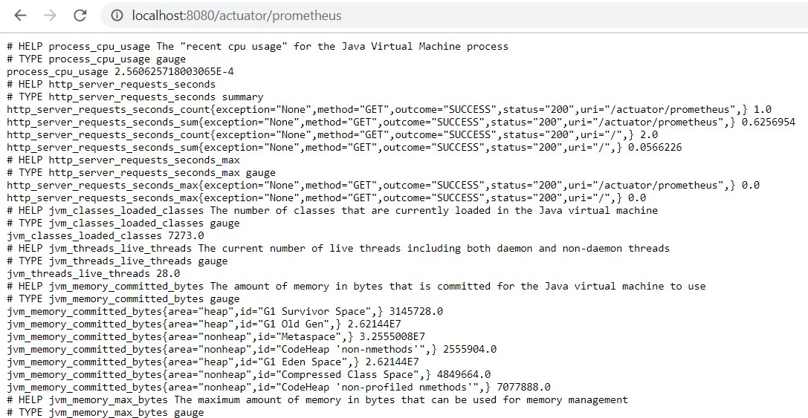
Micrometer Example
After adding the micrometer dependency, we have a new endpoint - /actuator/prometheus
The data is formatted in specific for Prometheus format

Slide 39

Prometheus

Slide 40
Prometheus
Time-series database that stores the metric data by pulling it (using a built-in data scraper) periodically over HTTP
Intervals between pulls can be configured
Has a simple user interface where we can visualize/query on all of the collected metrics
To configure Prometheus more precisely we using the prometheus.yaml file

Slide 41
Download and Configure Prometheus
You can download Prometheus from here
Configure Prometheus with prometheus.yaml file
global:
scrape_interval: 15s # By default, scrape targets every 15 seconds.
# A scrape configuration containing exactly one endpoint to scrape:
# Here it's Prometheus itself.
scrape_configs:
# The job name is added as a label `job=<job_name>` to any timeseries scraped from this config.
- job_name: 'prometheus'
# Override the global default and scrape targets from this job every 5 seconds.
scrape_interval: 5s
static_configs:
- targets: ['localhost:9090']

Slide 42
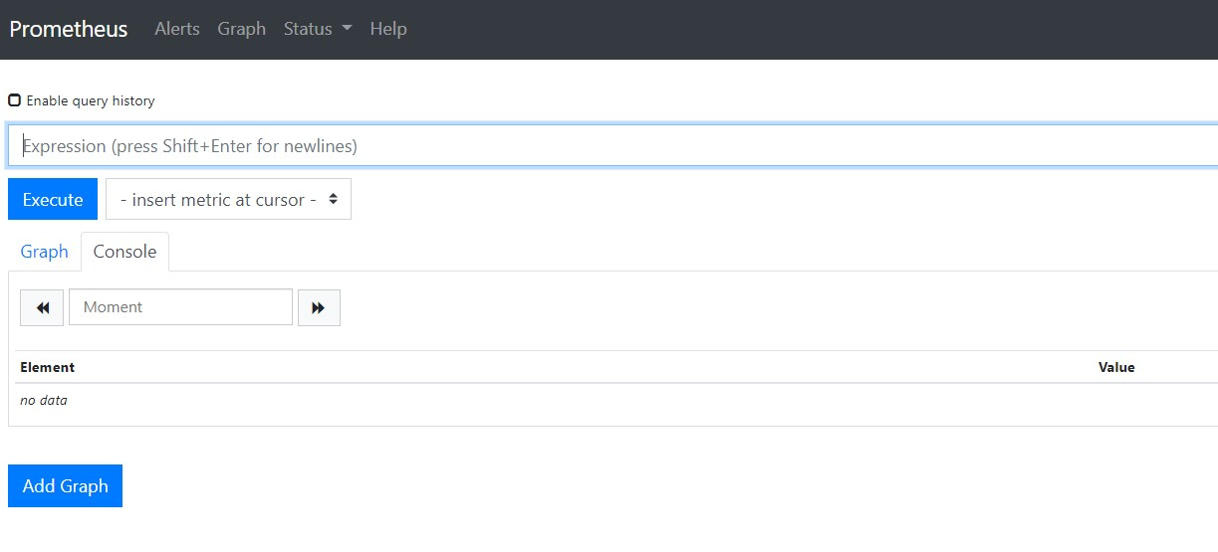
Prometheus Dashboard
After starting Prometheus, we can access it on http://localhost:9090

Slide 43
Prometheus Query Language – PromQL (1)
Prometheus provides a functional query language called PromQL (Prometheus Query Language)
Let's the user select and aggregate time series data in real time
Result of an expression can either be shown as a graph, viewed as tabular data in Prometheus' expression browser, or consumed by external systems via the HTTP API

Slide 44
Prometheus Query Language – PromQL (2)
Return all time series with the metric http_requests_total and the given job and handler labels
Return a whole range of time for the same vector
Using regular expressions
http_requests_total{job="apiserver", handler="/api/comments"}
http_requests_total{job="apiserver", handler="/api/comments"}[5m]
http_requests_total{job=~".*server"}
http_requests_total{status!~"4.."}

Slide 45

Summary
…
…
…
Deployment means to push changes or update from one environment to another
Micrometer solves the problem of being a vendor-neutral data provider
Prometheus is a Time-series database that stores the metric data by pulling it (using a built-in data scraper) periodically over HTTP

Slide 46
Questions?
Notes:
46

Slide 47












SoftUni Diamond Partners

Slide 48


Educational Partners

Slide 49
Trainings @ Software University (SoftUni)
Software University – High-Quality Education, Profession and Job for Software Developers
softuni.bg, about.softuni.bg
Software University Foundation
softuni.foundation
Software University @ Facebook
facebook.com/SoftwareUniversity
Software University Forums
forum.softuni.bg
Notes:
49

Slide 50

License
This course (slides, examples, demos, exercises, homework, documents, videos and other assets) is copyrighted content
Unauthorized copy, reproduction or use is illegal
© SoftUni – https://about.softuni.bg/
© Software University – https://softuni.bg
Notes:
50

